Slide 1
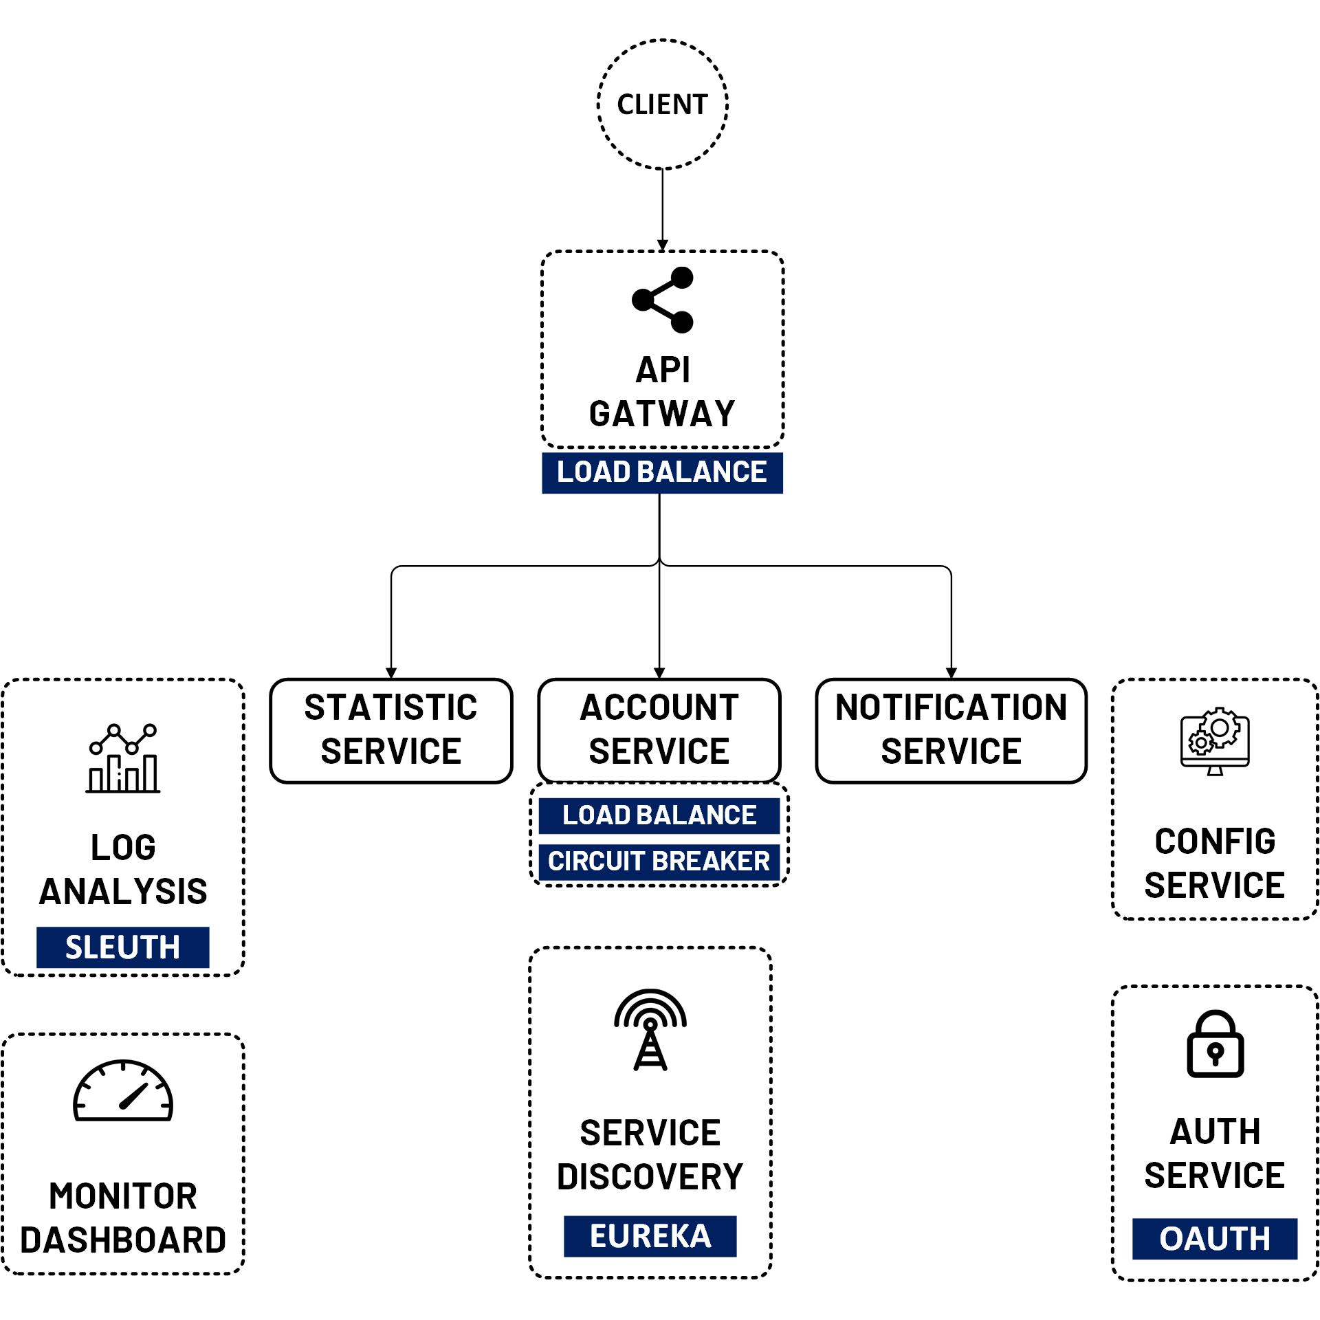

OAuth 2 Security
www.jmaster.io/course/microservices-with-spring-cloud

Slide 2
OAuth 2.0
OAuth 2.0 is the industry-standard protocol for authorization
Provide simple and secure flow for web, mobile and desktop applications, others
Grant third-party applications to access protected resource on behalf of owner or itself with access token.
OAuth 2.0 is the right choice for securing their APIs

Slide 3
OAuth 2.0 Roles
Resource Server: Server hosting the protected resources
Resource Owner: An entity (End User) capable of granting access to a protected resource.
Client: Application requesting access to a protected resource on behalf of the Resource Owner.
Authorization Server: Server that authenticates the Resource Owner and issues access tokens after getting proper authorization.

Slide 4
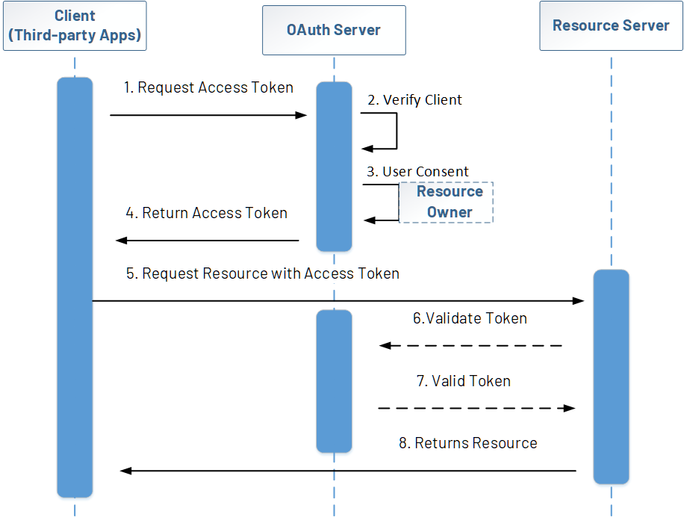

Slide 5
Access vs Refresh Token
Access Token: a authorized string issued to client with scopes and short expired time.
Resource owner grants token. OAuth Server generates it. Resource Server verifies valid token
Refresh Token: issued along with access token, longer expired time to request a new access token from OAuth Server
JSON Web Token (JWT): is a way to encode all relevant parts of an token (JSON) into the signed token itself (String)

Slide 6
Client Registration
Must register client application with the OAuth Server
Application Name and Website
Redirect URI or Callback URL after user authorize (or deny), client application will handle authorization codes or access tokens.
Client ID and Client Secret are client credentials issued by OAuth Server. Client ID is public , Client Secret is private
Scopes: limit access grant of client to owner’s resource
Grant types: are flows to get an access token

Slide 7
Grant types
Authorization Code
Client Credentials
Device Code
Refresh Token
Implicit Flow
Password Flow

Slide 8
Reference
https://oauth.net/

